Slide 1
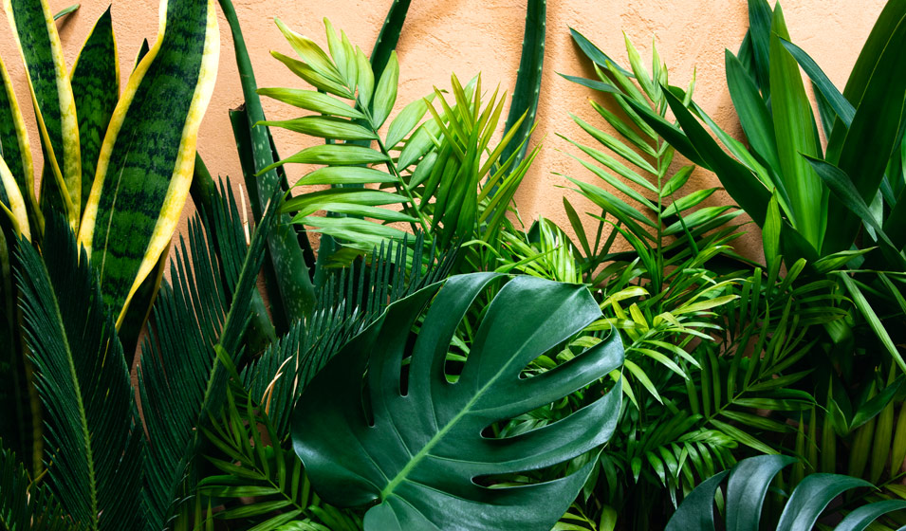
THE FIVE KINGDOMS
By Vaha, Justine, wycliffe and Eldrich

Slide 2
Kingdom one
Plants, the most important thing about life. The Kingdom that keeps everyone alive. Know about them more in this Chapter/Kingdom.
PLANTS.

Slide 3
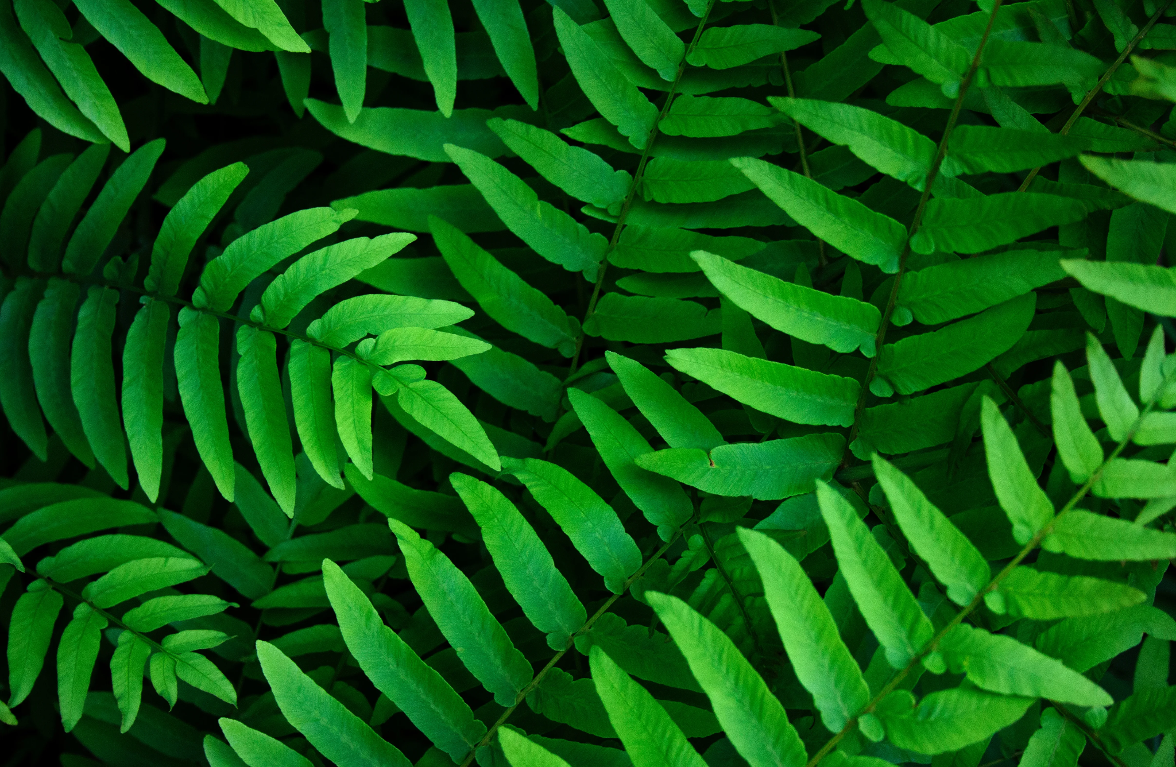
Plants(Justine, Exp. 1)
What are plants? Plants are an important part of life, they provide us Oxygen, tree is a plant and trees are an important part of life. Plants follow the MRS GREN, the seven life processes. Plants are an important species of life, they are homes of many insects, small reptiles and even a spider! Not like animals, some plants eat the light from the Sun. Trees and Flowers eat the light of the sun! This process is called photosynthesis. In reproduction, they reproduce in the process of pollination. There are over 200,000 identified plant species and the list is growing all the time. 90 percent of the foods humans eat come from just 30 plants. An average size tree can provide enough wood to make 170,100 pencils thats alot of pencils!

Slide 4
Types Of Plants
CLICK
Some types of plants are:
Trees, Flowers, Wild Flowers(Any Flowers) and More.
RANDOM STUFFS:
Plants have been in Earth since 700M years ago and is still here. Today, we’re fearing that some trees are being cut too much.

Slide 5
Kingdom two
Fungi, you might notice them as just mushrooms, but they’re more than just poisonous mushrooms. Find out in this Chapter/Kingdom.
FUNGI.

Slide 6
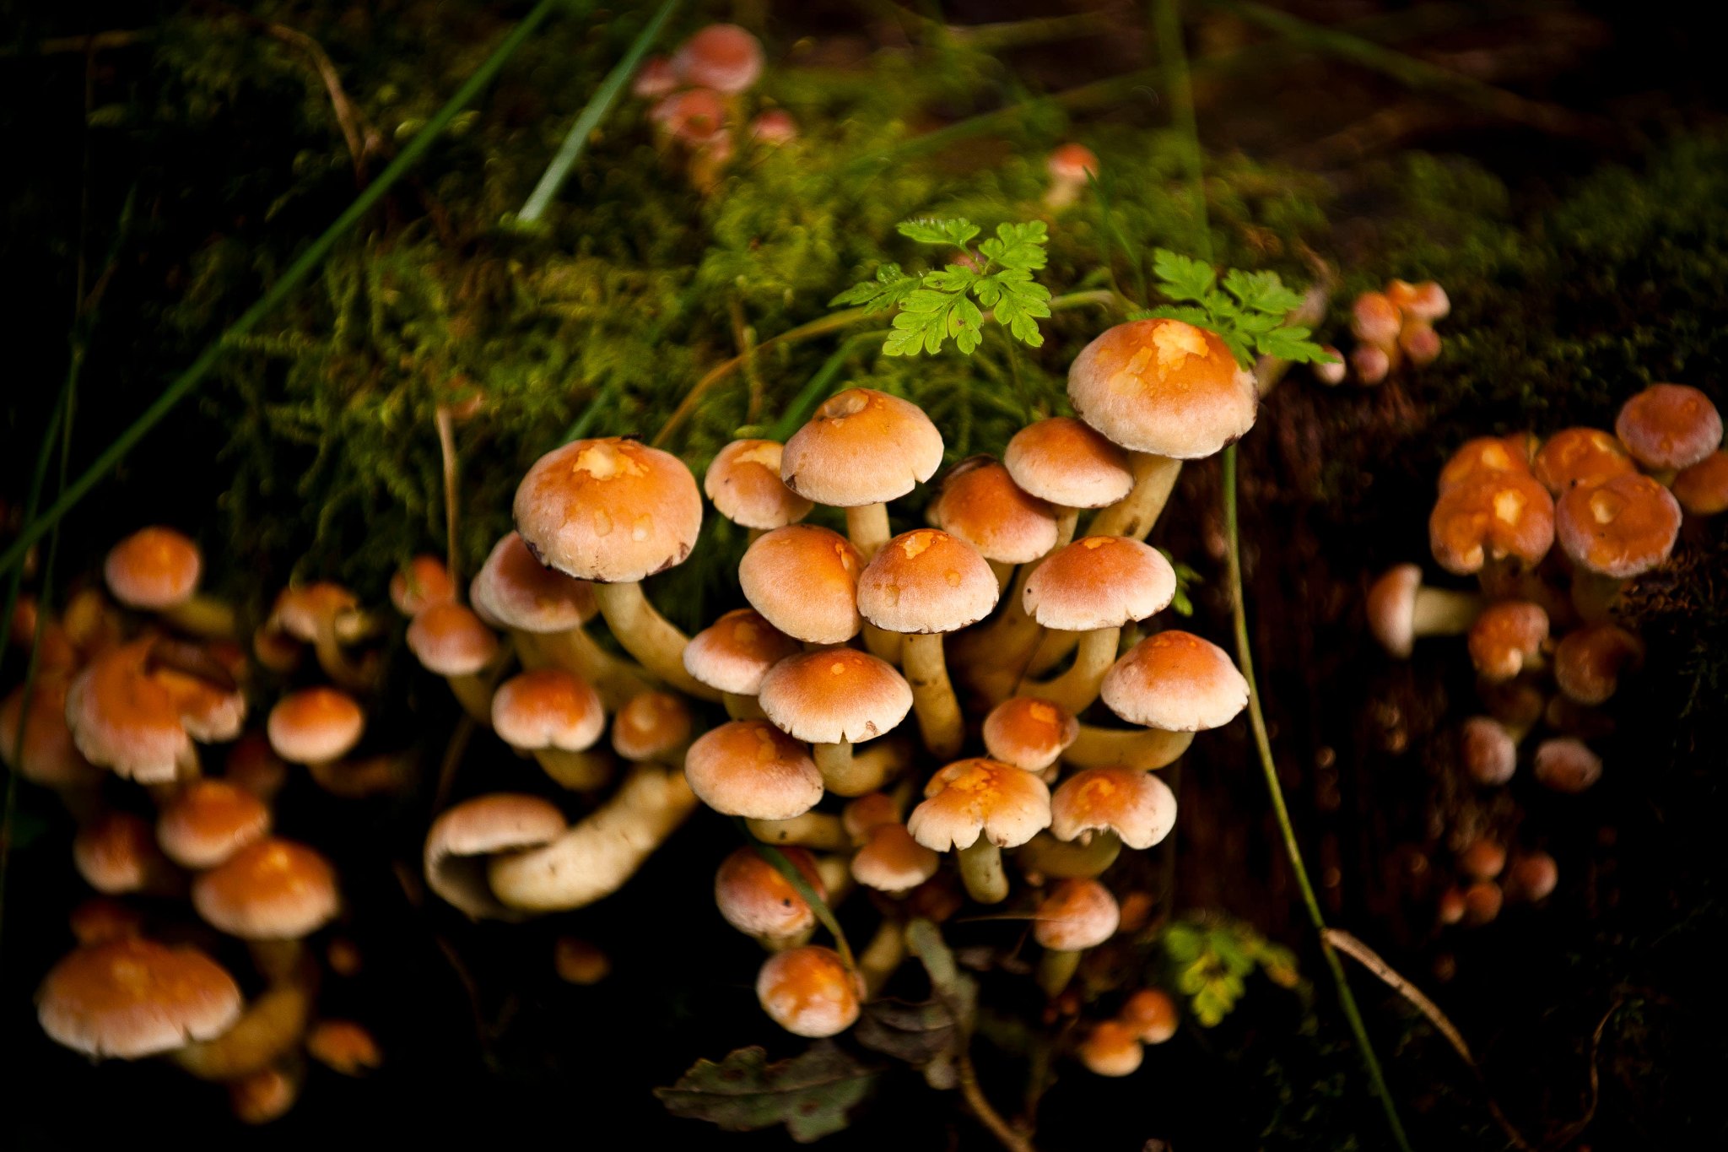
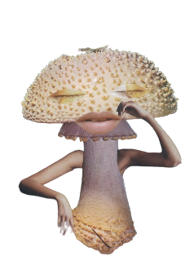
A fungus is any member of the group of eukaryotic organisms that includes microorganisms such as yeasts and molds, as well as the more familiar mushrooms.

Slide 7
Kingdom three
Animals, what are they? Welp, you’ll know what they are in the next slide(s).
ANIMALS.

Slide 8
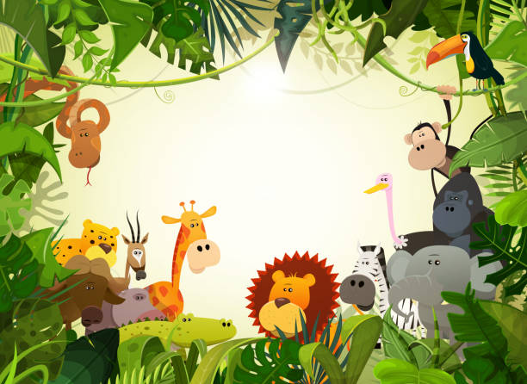
animals
Animals are multicellular, eukaryotic organisms in the biological kingdom Animalia. With few exceptions, animals consume organic material, breathe oxygen, and are able to move, they are able to reproduce (make offspring) and grow from a hollow sphere of cells, the blastula, during embryonic development. There are about 7.7 million different sorts of animals around the world

Slide 9
Kingdom four
Bacteria, Germs, Viruses whatever you call them. You might think that they’re very dangerous and deadly, but there’s more.
BACTERIA.

Slide 10
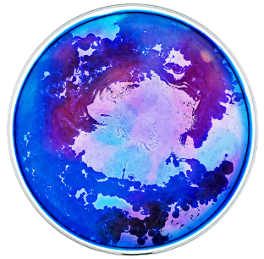
Bacteria are small single-celled organisms. Bacteria are found almost everywhere on Earth and are vital to the planet's ecosystems. Some species can live under extreme conditions of temperature and pressure. The human body is full of bacteria, and in fact is estimated to contain more bacterial cells than human cells.
Did you know?

Slide 11
Kingdom Five
PROTISTA.

Slide 12
Protista
Protista, it’s appearance is familiar to the 4th Kingdom - Bacteria - they act as pathogens to humans,

Slide 13
THE END

